Slide 1
Constructor destructor

Slide 2
It is a __________ error to pass arguments to a destructor.
logical
virtual
syntax
linker

Slide 3
c
syntax

Slide 4
Which constructor function is designed to copy objects of the same class type?
Create constructor
Object constructor
Dynamic constructor
Copy constructor

Slide 5
d

Slide 6
Which of the following gets called when an object is being created?
constructor
virtual function
destructor
main

Slide 7
a

Slide 8
Which of the following implicitly creates a default constructor when the programmer does not explicitly define at least one constructor for a class?
Preprocessor
Linker
Loader
Compiler

Slide 9
d

Slide 10
A destructor takes __________ arguments.
one
two
three
no

Slide 11
d

Slide 12
If the programmer does not explicitly provide a destructor, then which of the following creates an empty destructor?
Preprocessor
Compiler
Linker
main()function

Slide 13
b

Slide 14
#include <iostream>
using namespace std;
class Point
{
int x, y;
public:
Point(const Point &p)
{ x = p.x; y = p.y; }
int getX() { return x; }
int getY() { return y; }
};
int main()
{
Point p1;
Point p2 = p1;
cout << "x = " << p2.getX() << " y = " << p2.getY();
return 0;
}
x = garbage value y = garbage value
x = 0 y = 0
Compiler Error
Run time error

Slide 15
c
Explanation
There is compiler error in line "Point p1;".
The class Point doesn\'t have a constructor without any parameter.
If we write any constructor, then compiler doesn\'t create the default constructor.
It is not true other way, i.e., if we write a default or parameterized constructor, then compiler creates a copy constructor.

Slide 16
#include <iostream>
using namespace std;
class Point
{
int x, y;
public:
Point(int i = 0, int j = 0) { x = i; y = j; }
int getX() { return x; }
int getY() { return y; }
};
int main()
{
Point p1;
Point p2 = p1;
cout << "x = " << p2.getX() << " y = “;
cout << p2.getY();
return 0;
}
Compiler Error
x = 0 y = 0
x = garbage value y = garbage value
Run time error

Slide 17
b
Explanation
Compiler creates a copy constructor if we don\'t write our own.
Compiler writes it even if we have written other constructors in class. So the above program works fine. Since we have default arguments, the values assigned to x and y are 0 and 0.

Slide 18
#include<iostream>
#include<stdlib.h>
using namespace std;
class Test
{
public:
Test()
{ cout << \"Constructor called\"; }
};
int main()
{
Test *t = (Test *) malloc(sizeof(Test));
return 0;
}
Constructor called
Empty
Compiler Error
Runtime error

Slide 19
b
Explanation
Unlike new, malloc() doesn\'t call constructor (See this) If we replace malloc() with new, the constructor is called, see this.

Slide 20
#include < iostream >
using namespace std;
class Test
{
public:
Test() {
cout << "Hello from Test() "; }
} a;
int main()
{
cout << "Main Started ";
return 0;
}
Main Started
Main Started Hello from Test()
Hello from Test() Main Started
Compiler Error: Global objects are not allowed

Slide 21
c
Explanation
Output is
Hello from Test() Main Started
There is a global object 'a' which is constructed before the main functions starts, so the constructor for a is called first, then main() execution begins.

Slide 22
#include<iostream>
#include<string.h>
using namespace std;
class String
{
char *str;
public:
String(const char *s);
void change(int index, char c)
{ str[index] = c; }
char *get()
{ return str; }
};
String::String(const char *s)
{
int l = strlen(s);
str = new char[l+1];
strcpy(str, s);
}
int main()
{
String s1("geeks");
String s2 = s1;
s1.change(0, 'G');
cout << s1.get() << " ";
cout << s2.get();
}
Geeks geeks
Geeks Geeks
geeks geeks
geeks Geeks

Slide 23
b
Explanation
Since there is no copy constructor, the compiler creates a copy constructor.
The compiler created copy constructor does shallow copy in line
" String s2 = s1;"
So str pointers of both s1 and s2 point to the same location.
There must be a user defined copy constructor in classes with pointers to dynamic memory allocation
C++ compiler implicitly creates a copy constructor and overloads the assignment operator to perform shallow copy at compile time.

Slide 24
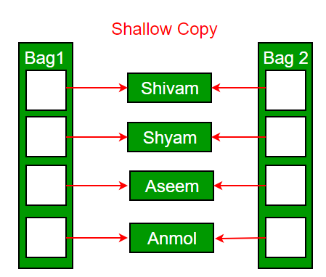
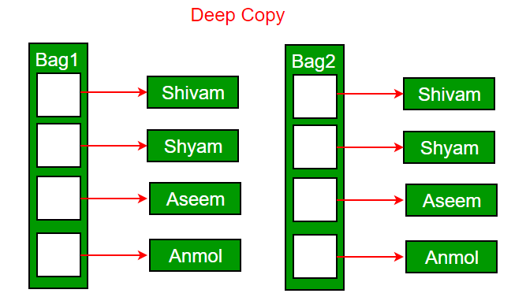
If we don’t define our own copy constructor, the C++ compiler creates a default copy constructor for each class which does a member-wise copy between objects.
Deep copy is possible only with a user-defined copy constructor.
In a user-defined copy constructor, we make sure that pointers (or references) of copied objects point to new memory locations.

Slide 25
Predict the output of following program.
#include<iostream>
using namespace std;
class Point {
int x;
public:
Point(int x) { this->x = x; }
Point(const Point p) { x = p.x;}
int getX() { return x; }
};
int main()
{
Point p1(10);
Point p2 = p1;
cout << p2.getX();
return 0;
}
10
Compiler Error: p must be passed by reference
Garbage value
None of the above

Slide 26
b
Explanation
Objects must be passed by reference in copy constructors.
Compiler checks for this and produces compiler error if not passed by reference.
The following program compiles fine and produces output as 10.
Point(const Point &p) { x = p.x;}
The reason is simple, if we don't pass by reference, then argument p1 will be copied to p.
So there will be a copy constructor call to call the copy constructor, which is not possible.

Slide 27
#include <iostream>
using namespace std;
int i;
class A
{
public:
~A()
{
i=10;
}
};
int foo()
{
i=3;
A ob;
return i;
}
int main()
{
cout << foo() << endl;
return 0;
}
0
3
10
None of the above

Slide 28
b
Explanation
While returning from a function, destructor is the last method to be executed. The destructor for the object “ob” is called after the value of i is copied to the return value of the function. So, before destructor could change the value of i to 10, the current value of i gets copied & hence the output is i = 3

Slide 29
#include <iostream>
using namespace std;
class A
{
int id;
static int count;
public:
A() {
count++;
id = count;
cout << \"constructor for id \" << id << endl;
}
~A() {
cout << \"destructor for id \" << id << endl;
}
};
int A::count = 0;
int main() {
A a[3];
return 0;
}

Slide 30
a)
constructor for id 1
constructor for id 2
constructor for id 3
destructor for id 3
destructor for id 2
destructor for id 1
b)
constructor for id 1
constructor for id 2
constructor for id 3
destructor for id 1
destructor for id 2
destructor for id 3
c)
Compiler Dependent.
d)
constructor for id 1
destructor for id 1

Slide 31
a
Explanation
In the above program, id is a static variable and it is incremented with every object creation. Object a[0] is created first, but the object a[2] is destroyed first. Objects are always destroyed in reverse order of their creation. The reason for reverse order is, an object created later may use the previously created object. For example, consider the following code snippet.
A a;
B b(a);
In the above code, the object ‘b’ (which is created after ‘a’), may use some members of ‘a’ internally. So destruction of ‘a’ before ‘b’ may create problems. Therefore, object ‘b’ must be destroyed before ‘a’.

Slide 32
What is the right way to declare a copy constructor of a class if the name of the class is MyClass?
MyClass (constant MyClass *arg)
MyClass (constant MyClass &arg)
MyClass (MyClass arg)
MyClass (MyClass *arg)

Slide 33
B (c++)
Explanation
In this question, language is not specified so there can be multiple options correct.
MyClass (constant MyClass &arg) // copy constructor in C++
MyClass (MyClass arg) // copy constructor in Java

Slide 34
Which of the followings is/are automatically added to every class, if we do not write our own.
Copy Constructor
Assignment Operator
A constructor without any parameter
All of the above

Slide 35
d
In C++, if we do not write our own, then compiler automatically creates a default constructor, a copy constructor and a assignment operator for every class.

